Slide 1

NLP: Recurrent Neural Network
Video 11: Understanding Long Short Term Memory Network

Slide 2

Advanced RNN
RNN
GRU
LSTM

Slide 3
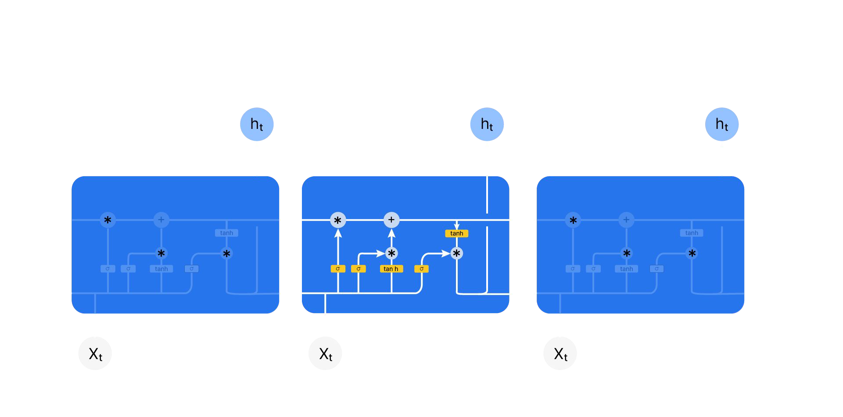
Introduction to LSTM
Long Short Term Memory (LSTM) excels at capturing long-term dependencies making it ideal for sequence prediction.
y_{t}
^{y}t+1 ^{y}t+2
^{C}t-1
^{C}t+2
^{h}t-1
^{h}t+2
X_{t}
^{X}t+1
^{X}t+2

Slide 4
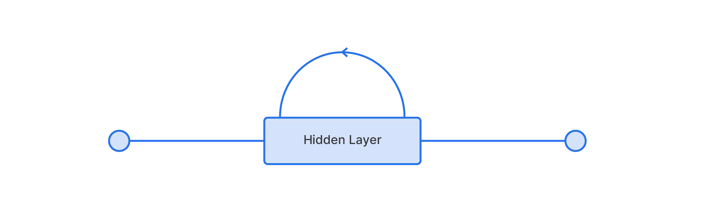
Introduction to LSTM
Structure of a Simple RNN

Slide 5

Introduction to LSTM
Selectively recall short term or long term memory
LTM
STM
Structure of LSTM

Slide 6
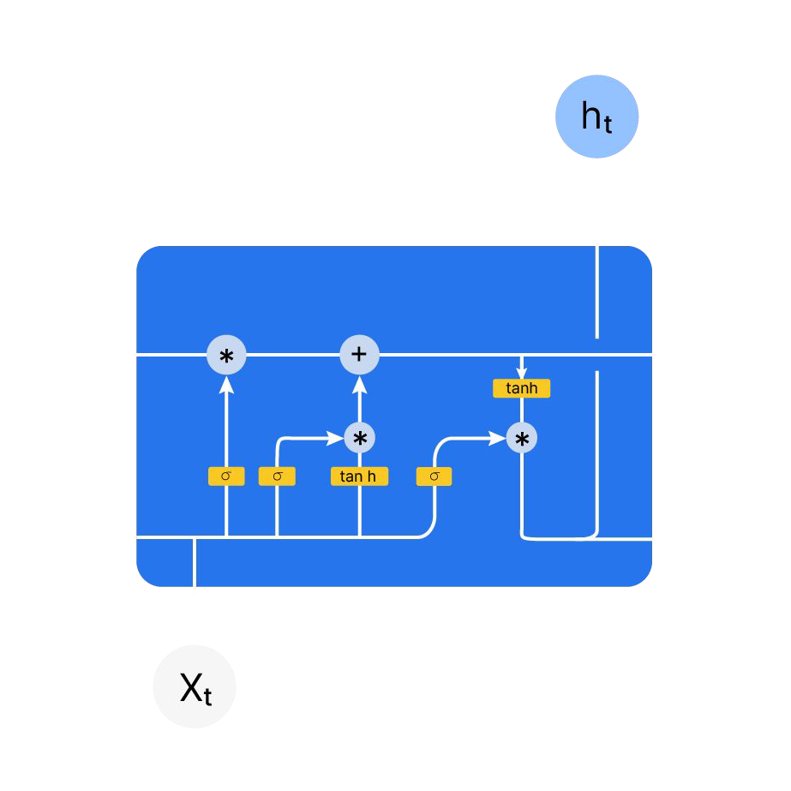
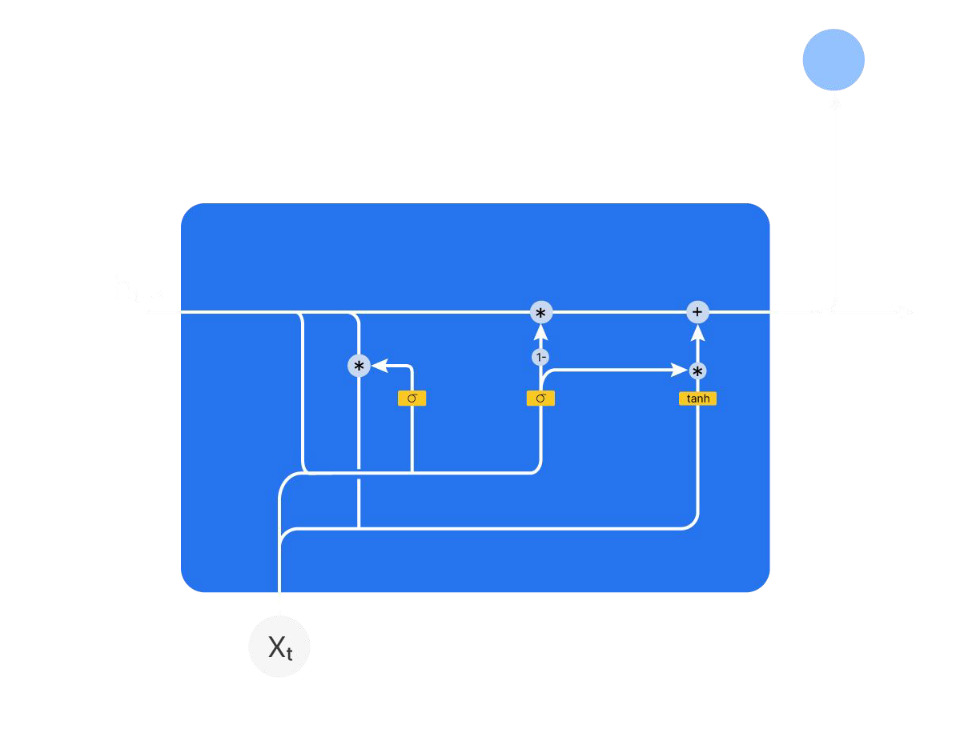
RNN V/s GRU
GRU
LSTM
y_{t}
y_{t}
^{h}t-1
h_{t}
^{C}t-1
C_{t}
^{h}t-1
h_{t}
X_{t}

Slide 7
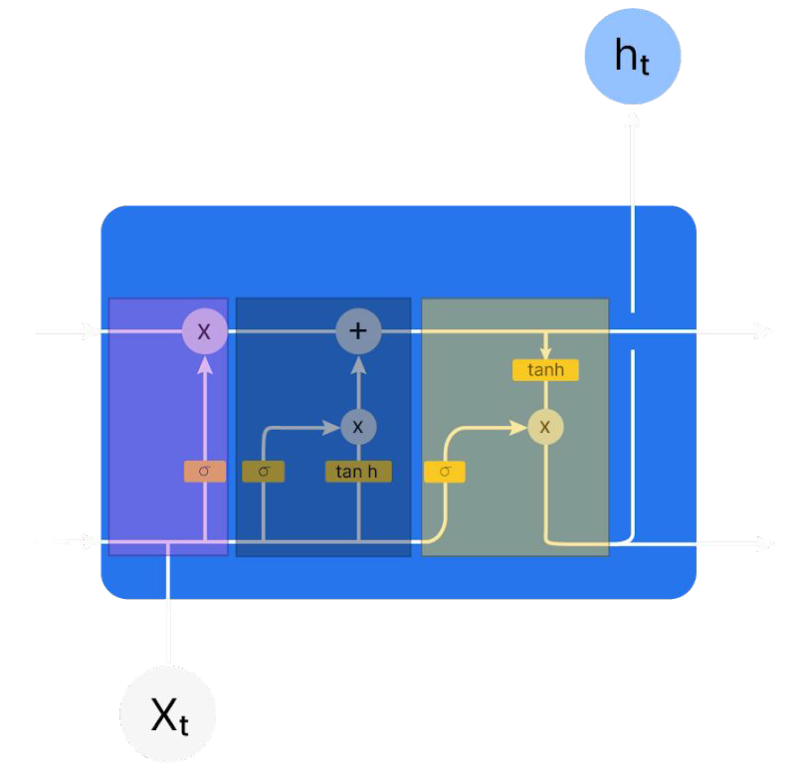
RNN V/s GRU
GRU
LSTM
y_{t}
y_{t}
Reset gate
Update gate
Forget Gate
Input Gate
Output Gate
^{h}t-1
h_{t}
^{C}t-1
C_{t}
^{h}t-1
h_{t}
X_{t}

Slide 8
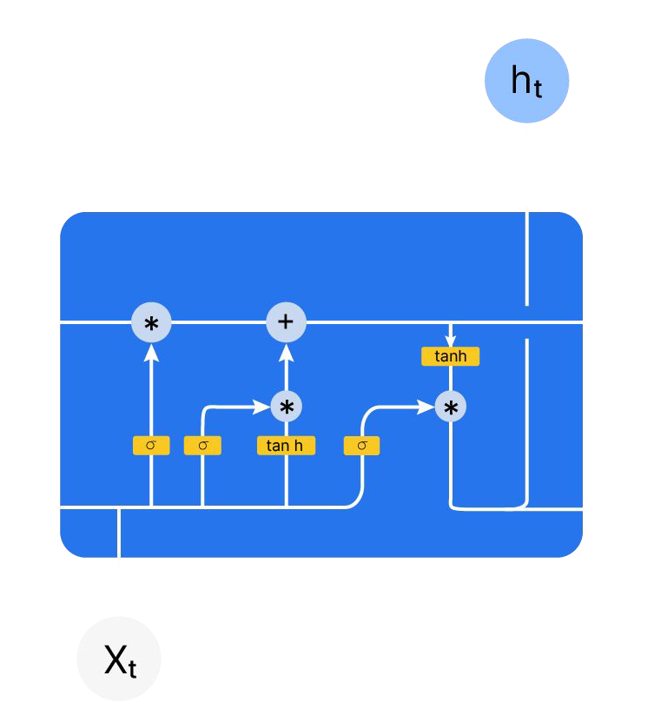
RNN V/s GRU
GRU
LSTM
y_{t}
y_{t}
Cell state C_{t}
^{h}t-1
h_{t}
^{C}t-1
^{h}t-1
h_{t}
h_{t}= U_{g}*(ĥ_{t}) + (1-U_{g})*h_{t-1}
C_{t}= (F_{g})(C_{t-1} ) + i_{g}*(Ĉ_{t})
X
t
h_{t}= O_{g}*(tanh(C_{t}))

Slide 9
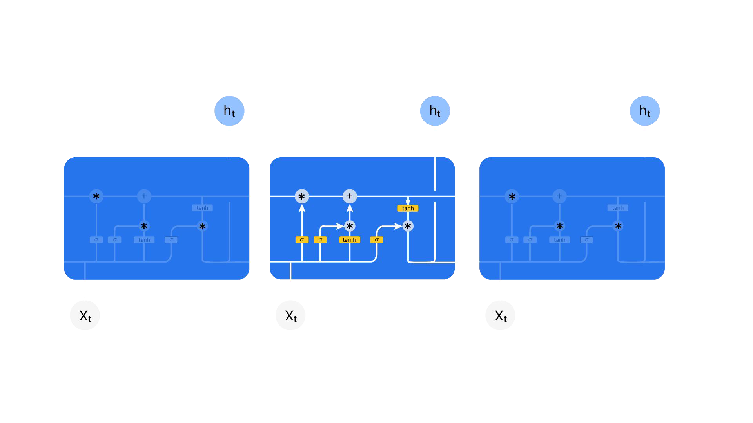
LSTM Architecture
y_{t}
^{y}t+1
^{y}t+2
^{C}t-1
^{C}t+2
^{h}t-1
^{h}t+2
X_{t}
^{X}t+1
^{X}t+2

Slide 10
LSTM Architecture
y_{t}
Forget Gate Input Gate Output Gate
Forget Gate: Decides informations to discard from the cell state
Input Gate: Decides new information to add to the cell state.
Output Gate: Determines the
C
C
t-1
t
^{h}t-1
h
current time step's hidden state (h ).
t
t

Slide 11
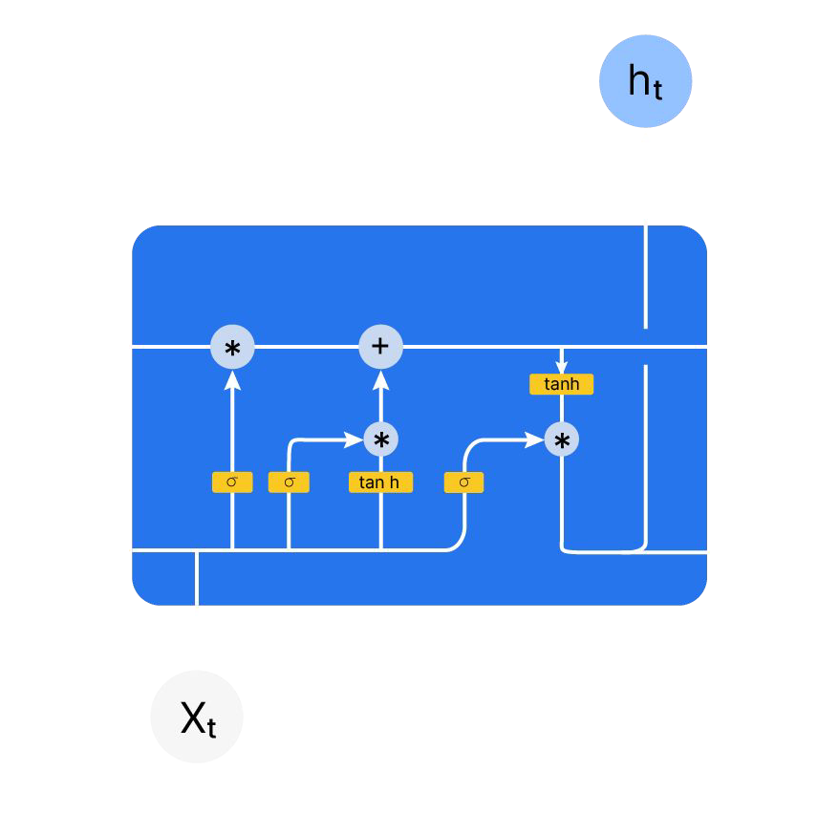



Understanding LSTM Process
y_{t}
Previous cell state C_{t-1}
Previous hidden state h_{t-1}
Current input X_{t}

Slide 12
Understanding LSTM Process
y_{t}
C_{t}
C_{t}= (F_{g})(C_{t-1} ) + i_{g}*(Ĉ_{t})
h_{t}
h_{t}= O_{g}*(tanh(C_{t}))

Slide 13
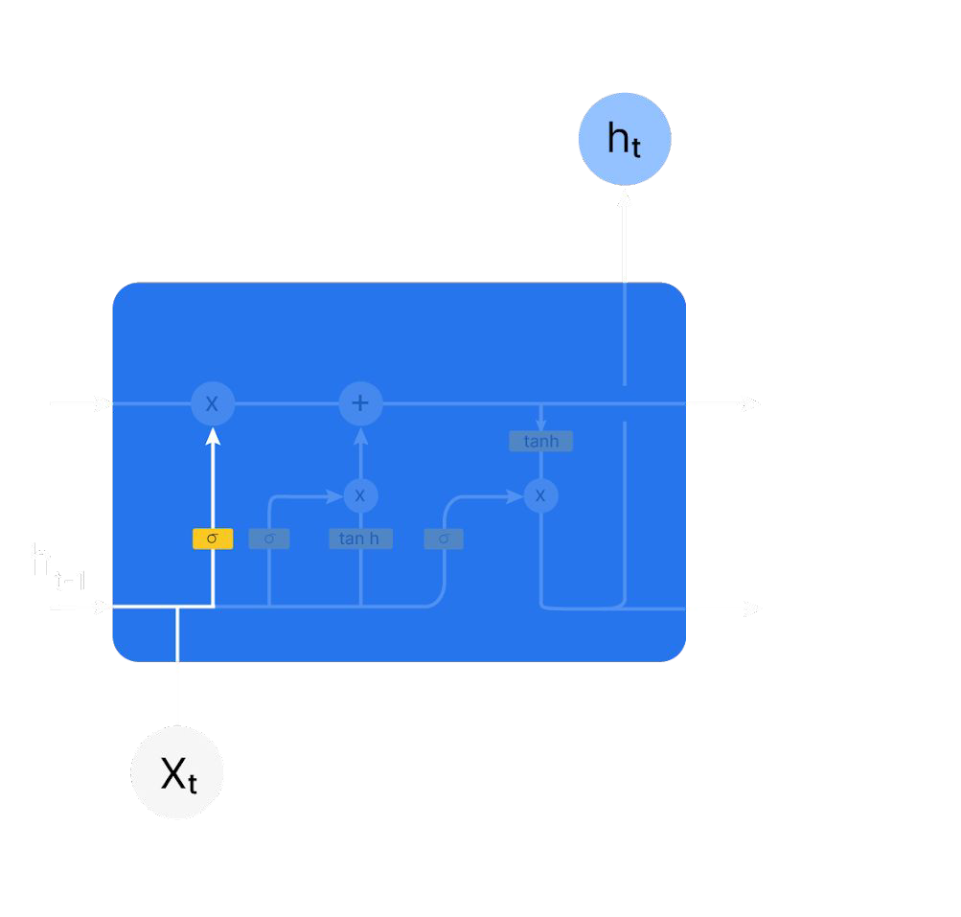

Understanding LSTM Process
y_{t}
Forget Gate
^{C}t-1
C_{t}
F_{g}= σ( W_{f} [X_{t} , h_{t-1} ]+ b_{f} )
F_{gf}
O_{t}
h_{t}

Slide 14
Understanding LSTM Process
y_{t}
Forget Gate
C_{t}
F_{g}= σ( W_{f} [X_{t} , h_{t-1} ]+ b_{f} )
^{C}t-1
F_{gf}
O_{t}
Outputs -> Between 0 and 1
0 → “Forget this completely”
1 → “Keep this entirely”
h_{t}

Slide 15
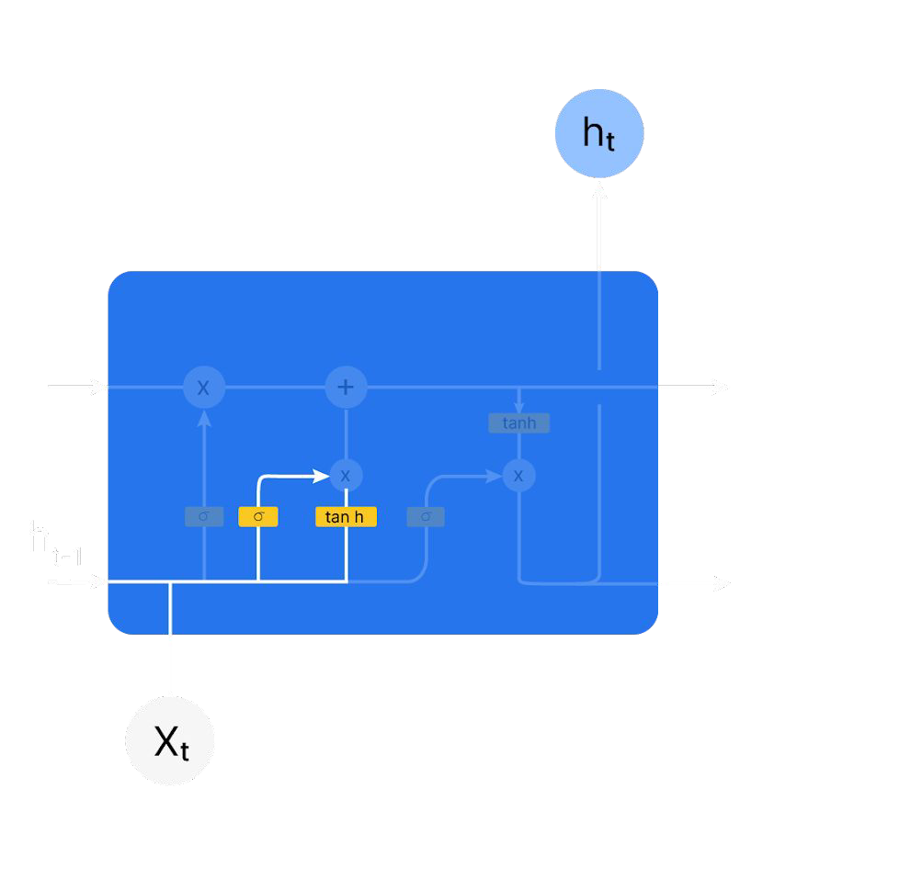
Understanding LSTM Process
y_{t}
Input Gate
^{C}t-1
C_{t}
i_{g} = σ( W_{i} [x_{t} , h_{t-1} ]+ b_{i} )
O_{t}
i
_{t}g
_{Ĉ}c
t
h_{t}

Slide 16
Understanding LSTM Process
y_{t}
New candidate Vector
Input Gate
Ĉ_{t}= tanh( W_{c} [x_{t} + h_{t-1} ]+ b_{c} )
^{C}t-1
C_{t}
O_{t}
i
_{t}g
_{Ĉ}c
t
h_{t}

Slide 17
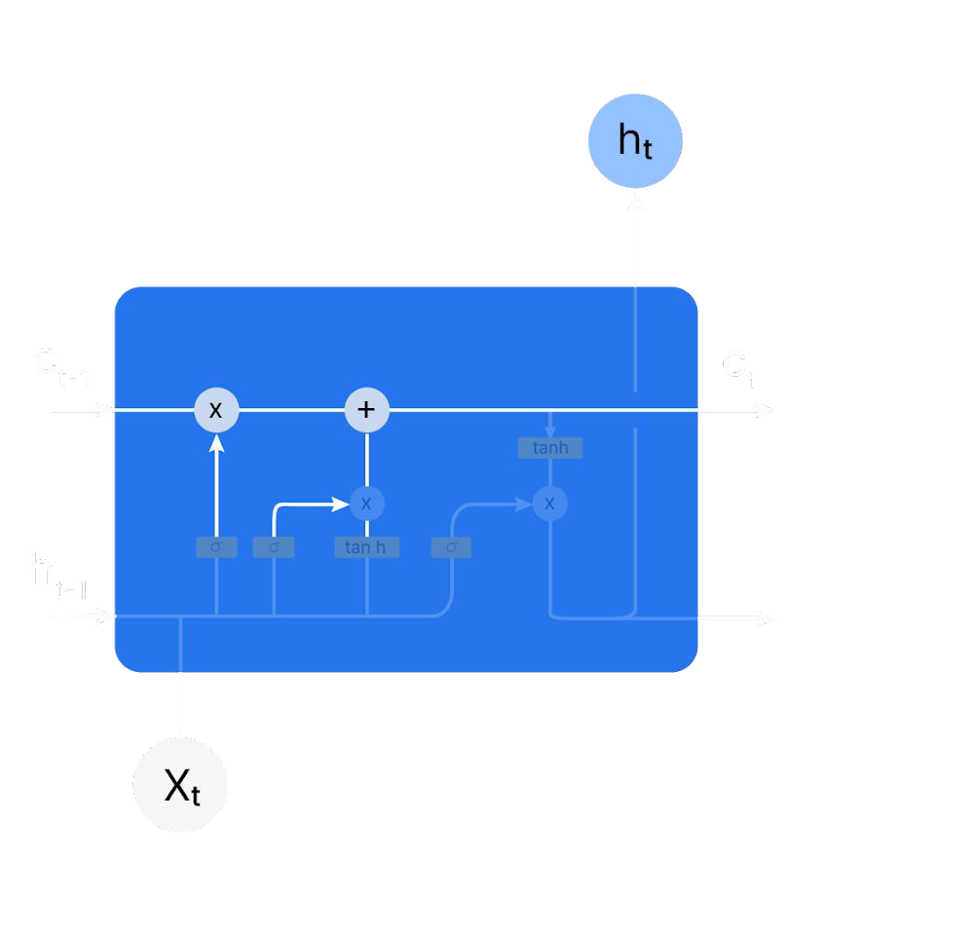
Understanding LSTM Process
y_{t}
Update the cell state :
C_{t}= (F_{g})(C_{t-1} ) + i_{g}*(Ĉ )
i_{tg}
^{O}tg
t
^{h}t-1
_{Ĉ}c
t
h_{t}

Slide 18
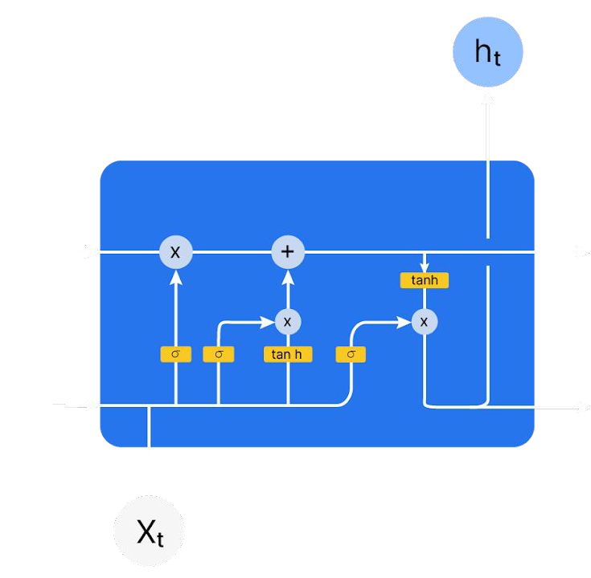
Understanding LSTM Process
y_{t}
Output Gate
C_{t}
O_{g} = σ( W_{o} [X_{t} , h_{t-1} ] + b_{o} )
^{C}t-1
^{O}tg
h_{t} = O_{g} * ( tanh ( C_{t} ))
i
_{t}g
_{Ĉ}c
^{h}t-1
t
h_{t}

Slide 19
Advanced RNN
RNN
GRU
LSTM

Slide 20
RNN V/s GRU
GRU
LSTM
y_{t}
y_{t}
Reset gate
Update gate
Forget Gate
Input Gate
Output Gate
^{h}t-1
h_{t}
^{C}t-1
C_{t}
^{h}t-1
h_{t}
X_{t}
Faster
Slower

Slide 21
Up Next: LSTM in Jupyter

